Slide 1
Developing A Successful School-Community Initiative to End Youth Homelessness
Heather Mosher, Ph.D.
Institute for Community Research
Mary Ann Haley, Ph.D.
Deputy Director
Connecticut Coalition to End Homelessness

Slide 2
Goals of today’s workshop
Be introduced to a promising model for local communities to end youth homelessness
Learn best practices for developing a successful community-based initiative
Work with your team to develop a preliminary plan for your community
Meet other teams across CT and learn from each other

Slide 3
What do we know about youth homelessness?
Estimated 3,000 homeless/housing unstable youth in our state
An average of 17% of high school age youth in CT were identified as homelessness/housing unstable
Over 40% indicated they had no permanent place to live for over a year
Reference: Connecticut Statewide Youth Count 2015

Slide 4
What do we know about youth homelessness?
Identifying homeless/unstably housed youth can be challenging
“Hidden” population
CT ranked 49th of all 50 states for identifying and educating homeless students
(Institute for Children, Poverty & Homelessness, 2015)
Need for strategies and partnerships to improve
Notes:
In a biannual survey of best practices for identifying and educating homeless students across the nation released by the Institute for Children, Poverty & Homelessness, Connecticut ranked 49th of all 50 states.

Slide 5
What do we know about youth homelessness?
Significantly increases risk and results in poor outcomes for young people
School: chronic absenteeism, drop out
Health: poor nutrition, physical/sexual assault, STD/HIV, drug addiction
Mental health: depression, anxiety, suicide
Delinquency: arrests, criminal record
Notes:
We know that without immediate and effective resources,
27% received special education services; 32% dropped out
89% of the young people were sexually active with an average of 5.6 sexual partners.
23.5% first experienced sexual intercourse at age 12 or under.
19.4% reported they had traded sex for money, a place to stay or drugs/alcohol. (Gordon study)
22% had Criminal Justice involvement (CT youth count)
50% were arrested at least once in their lifetime; 39% reported having been incarcerated in jail, prison, juvenile detention or a residential facility (Derrick Gordon, PhD and Bronwyn Hunter, PhD, Consultation Center, Yale School of Medicine)

Slide 6
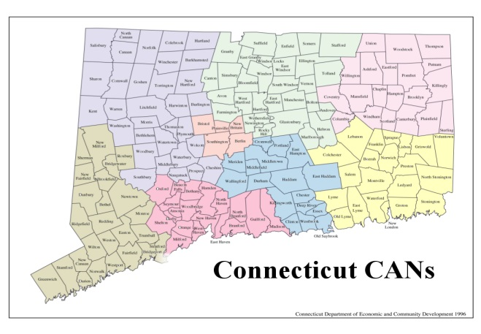
What works to end homelessness?
Collaboration + Resources + Data = Ending Homelessness
1. Collaboration
Coordinated Access Networks (CANs)
Resource Coordination
Streamlining Access
Partnerships with state agencies
2. Resources
Filling the Housing Gaps
3. Data
Using data to refine, correct, right-size
Notes:
This system change helps communities to focus on rapidly ending each person’s homelessness and connecting them with permanent housing as quickly as possible – shift focus of resources away from ‘managing homelessness’

Slide 7
Systems Working!
Collaboration + Resources + Data =
Ending Homelessness
CT first state to end chronic homelessness among veterans.
Second state to end all homelessness amongst all veterans (Feb 2016)
Notes:
This system change helps communities to focus on rapidly ending each person’s homelessness and connecting them with permanent housing as quickly as possible – shift focus of resources away from ‘managing homelessness’

Slide 8
Challenges Unique to YYA
1. Identifying and Reaching Youth
Less visible, shame, lack of awareness of services
Do not always come to adults for help
Need ways to identify youth who are in crisis and link them to resources
Youth connected to different types of people, places and institutions than adults
Need partnership with schools and other agencies
Methods of accessing different, texting v. phone
Notes:
1. Identifying and Engaging
Less Visible
Schools and other agencies needed
No centralized data-DCF, DMHAS, DOC, RHY
Releases more difficult
Shame
Lack of knowledge of services
Methods of accessing different, texting v. phone
Adult System gaps – no emergency services
Outreach hours and places
Assessing:
Designed for adults – diagnoses, chronicity
Process is different
Vulnerability scores are not indicators of housing/program/services needed
Who administers?
When do we assess?
What age do we assess?
Young families
What do we do if there are no good housing options?
Services and Linkages to Support:
Systems very complex and multiple layers, eligibility differs depending on funding sources
Conflicting definitions about homelessness
Increased risk factors
Harm reduction key, youth factors
Gaps between service providers, “aging out”
Collaboration between youth services complex
Importance of prevention
Family mediation and development of natural supports
Lack of Emergency Housing Options for Youth
Lack of longer term youth-specific housing
Data unclear on newer interventions, RRH
Outcomes:
Data challenges from multiple systems
What are we measuring?
How long do we measure?
Availability for follow-up
Complexity of youth vs. adult
Privacy
All of the above

Slide 9
Challenges Unique to YYA
2. Linking and Engaging Youth in Services
Lack of knowledge of resources available to meet young people’s needs
Barriers exist for youth to access resources
Gaps in age-appropriate resources
Need systems to share data, collaborate and coordinate services
Need youth input and involvement in designing systems and resources that work

Slide 10
Facing these Challenges
Systems need to change and adapt- we need to understand needs of youth and what will work best for them
Community collaboration - building on what already works – but refining as needed. Expanding this effort to include new local partners and development of regional teams/task forces, coordination, youth involvement and new resources.

Slide 11
Working towards ending youth homelessness in CT
Collaboration + Resources + Data = Ending Homelessness
School-Community Initiatives with Youth Voice
Results in other states:
improved access to health and social services, expansion of after school enrichment programs, reduced delinquency, and created stronger pathways to employment and post-secondary education
Connecticut first to develop/adapt model for addressing youth homelessness
Added key components based on what works
Pilot tested in Torrington – promising model

Slide 12
Components of the Community-based Model for Ending Youth Homelessness
Collaboration and Coordination
Collaboration and leadership among youth, school, youth-serving community orgs and institutions for a coordinated community response to identify, link to resources, and provide follow-up support.
+ Age-appropriate Resources
Utilize, improve and build on existing assets to provide accessible and effective wraparound services that are personalized to meet the needs of individual youth. Partner with youth to design and improve resources.
+ Data
Use youth participatory action research and asset mapping to identify assets in community, to understand what works and what doesn’t work and to continuously evaluate progress to improve outcomes.
= Ending Youth Homelessness
Notes:
Activities today will help you begin to build these core components into your plan.
When planning, think of:
The right mix of people, institutions, orgs that can help you achieve these goals. They may participate at different times, in different capacities, but may have a role to play in your community
xxx

Slide 13
Developing a Plan for Your Community
Your plan should include:
Long-term goal / shared vision
Short-term goals and activities that build momentum by achieving quick wins
Team that includes key stakeholders, including youth and local institutions
Strategies to engage youth, and build youth-adult partnerships and youth leadership
Data collection methods that engage community members in the analysis and community planning process
Communication strategies throughout the initiative

Slide 14
Team Activity: Define Goals
Define goals (use Handout A)
What do you hope to achieve in the short-term?*
Examples:
Map resources available in the community
Understand barriers to accessing existing resources
Community engagement to raise awareness and build new connections
What is your long-term vision?
Examples:
Effective identification of students experiencing homelessness
Age-appropriate resources for young people experiencing homelessness
Decrease school drop-outs and chronic absenteeism
Reduce youth homelessness to rare, brief, and episodic occurrences
*Note: set short-term goals to build momentum and achieve quick wins

Slide 15
Team Activity: Develop Plan
Handout B:
Step 1: Create timeline of activities based on goals
Overview timeline (guidebook pgs. 12-13)
Incorporate core components of model (pg. 7)
Use best practices / strategies that are successful
Youth participatory action research (pgs. 8, 19-24)
Participatory asset mapping (pgs. 8-9, 25-35)
Advisory/Homeroom lesson (handout)

Slide 16
Team Activity: Develop Plan
Handout B:
Step 2: Identify the right mix of leaders / partners
Guidebook pages: 12-16
Who will you ask to get involved?
Diverse representation (youth, school, community, institutions)
How will they contribute?
Define roles (steering group, working group, consultant, gatekeeper, supporter, funder)

Slide 17
Contact Info
Heather Mosher, Ph.D.
Community Psychologist / Researcher
Director, Youth Action Hub
Institute for Community Research
heather.mosher@icrweb.org
Mary Ann Haley, Ph.D.
Deputy Director
CT Coalition to End Homelessness
mhaley@cceh.org
Please visit & share widely: www.youth-help.org
Notes:
Point out youth-help.org

